Slide 1
Dealer Training

Slide 2
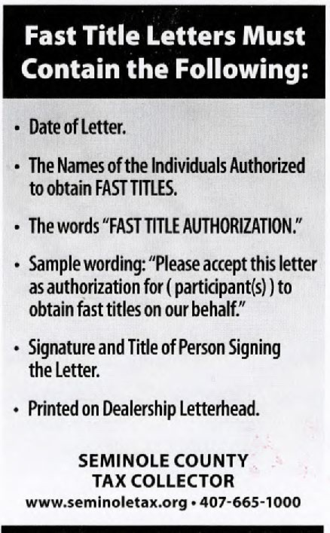
What Do I Need?
Pin number for the dealership (this authorizes whoever has the pin to process work)
HSMV 82040
Proof of Florida insurance (MUST have the 5-digit Florida code)
License plate number to transfer if applicable
If a fast title is requested, it must be written on the application and the agent from the dealership must be authorized to receive fast titles

Slide 3
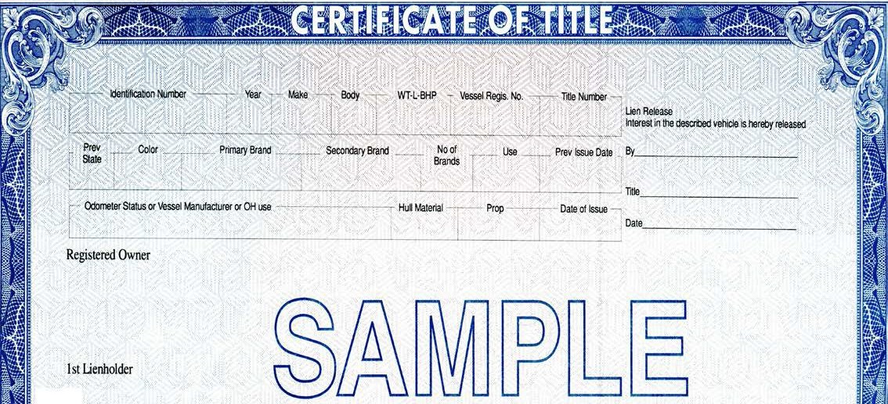
Florida Certificate of Title
Vehicle information – year, make, VIN, title number, and body type
Odometer status – reading/date read and date of issue
Seller(s) name and address
Lien status

Slide 4
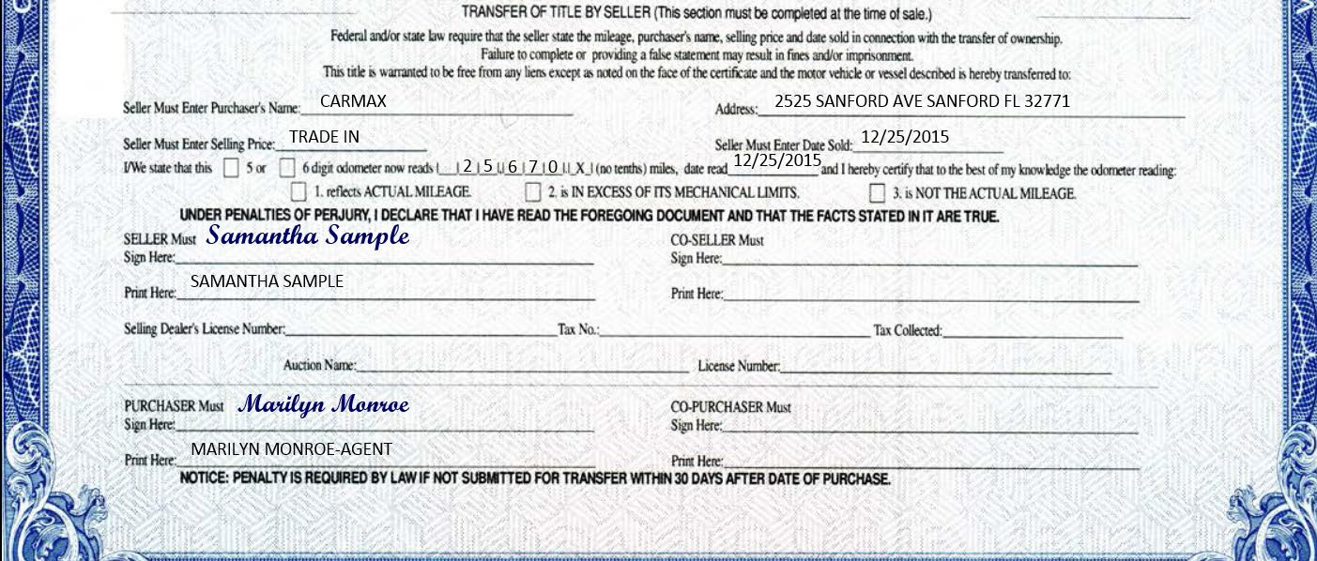
Florida Certificate of Title (transfer of title section)
Enter the purchaser’s name and address
Enter the date the vehicle was sold
Enter the odometer reading, status, and date read
Seller and purchaser must sign and print their name

Slide 5
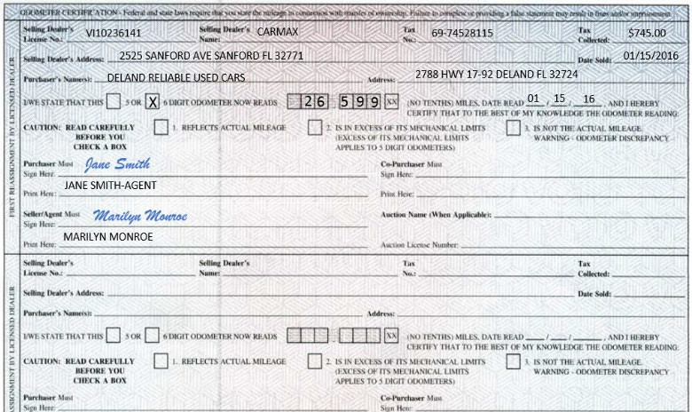
Florida Certificate of Title (back)
Each applicable re-assignment must be complete and accurate.

Slide 6
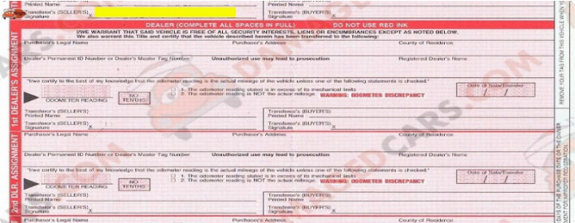
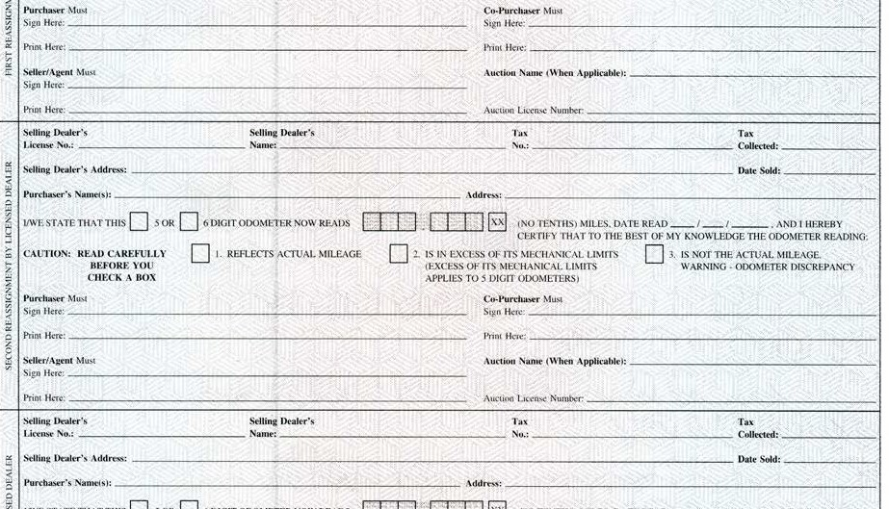
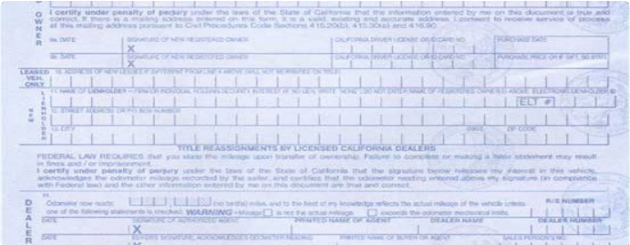
Dealer Re-Assignments
Be sure to read all out of state titles carefully. As a Florida dealer you must use any open re- assignments available on the title regardless if the out of state dealers used a separate re- assignment.
The same rule applies for Florida titles. If there are any open re-assignments on the back of the title, the Florida dealer must use them and cannot use an 82994.
Be sure to use the re- assignment section. Some out of state titles have applications on the back.
These are not re-assignments and cannot be used as such.

Slide 7
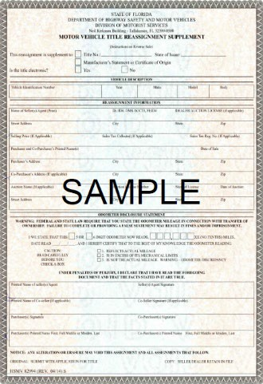
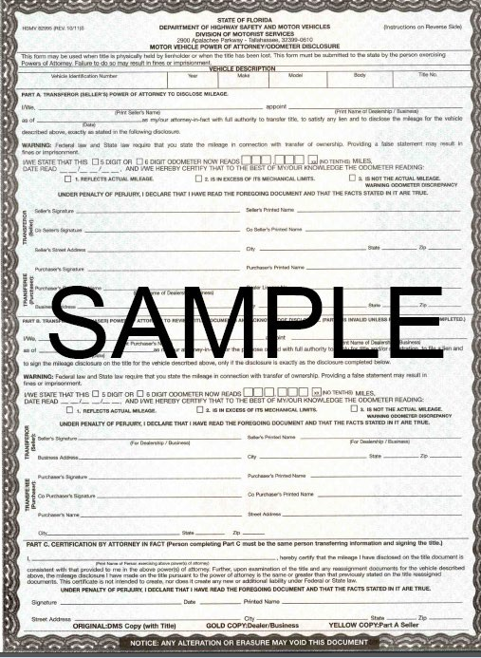
HSMV 82994 HSMV 82995
These secure forms must be original and are not available for print online

Slide 8
HSMV 82995 Secure Power of Attorney
Note: Federal and state laws prohibit an individual appointed as an attorney-in-fact from completing an odometer disclosure when acting as both transferor (seller) and transferee (buyer). However, a licensed dealer/business may be entitled to use form HSMV 82995, Motor Vehicle Power of Attorney/Odometer Disclosure, when one of the following applies:
The certificate of title is being held electronically
The certificate of title is physically being held by the lienholder
The certificate of title is lost
Note: The date on part C must be on or after the date the title became available.

Slide 9
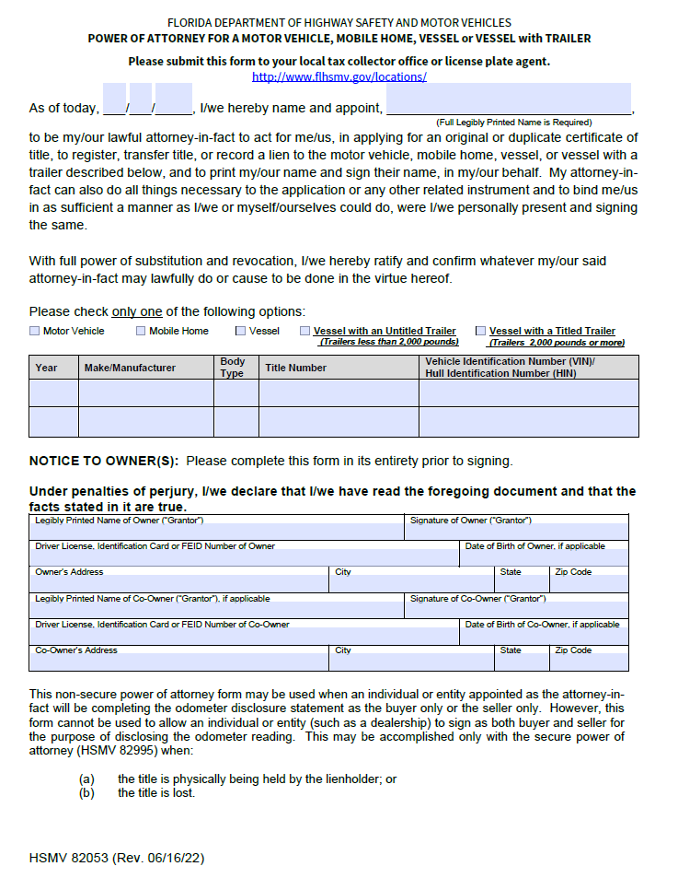
HSMV 82053 Non-Secure Power of Attorney (3rd party)
Name of Appointed person
NOT dealership name
If declaring an odometer reading, a 3rd party not affiliated with dealership must be appointed.
Never submit POA’s with the appointed name blank.
This form must be complete with no errors or omissions.
This form should only be used for one vehicle.
This form cannot be used to sign as buyer and seller when declaring an odometer reading.

Slide 10
HSMV 82040
HSMV 82040 MV
Form HSMV 82040 MV was updated July 2023
Use of the newest revision will be required as of January 1, 2024
The MV form will be used for vehicle types:
AU – Auto
BS – Bus
MC – Motorcycle
OH – Off-Highway
TO – Tools
TR – Truck
TT – Travel Trailers
VT – Vehicle Trailers
HSMV 82040 VS
Form HSMV 82040 VS was updated July 2023
Use of the newest revision will be required as of July 1, 2023
The VS form will be used for vehicle types:
Vessels
HSMV 82040 MH
Form HSMV 82040 MH was updated July 2023
Use of the newest revision will be required as of January 1, 2024
The VS form will be used for vehicle types:
Mobile Homes

Slide 11
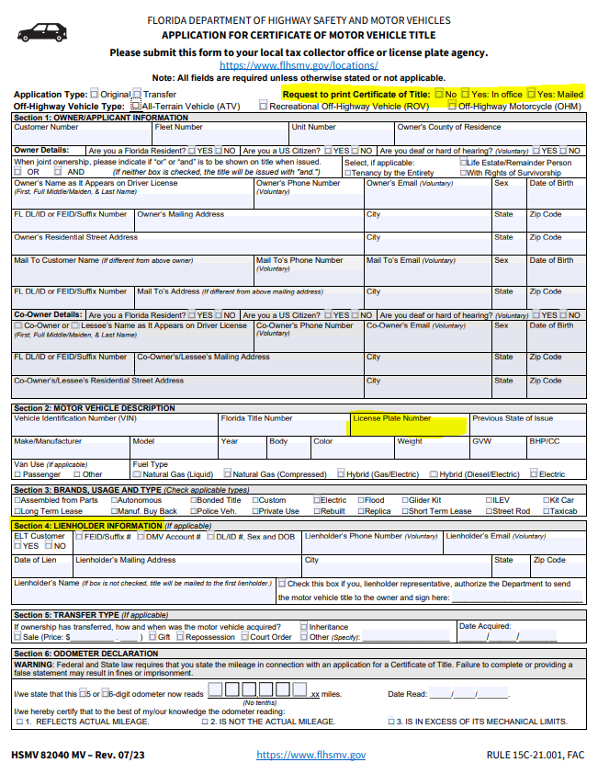
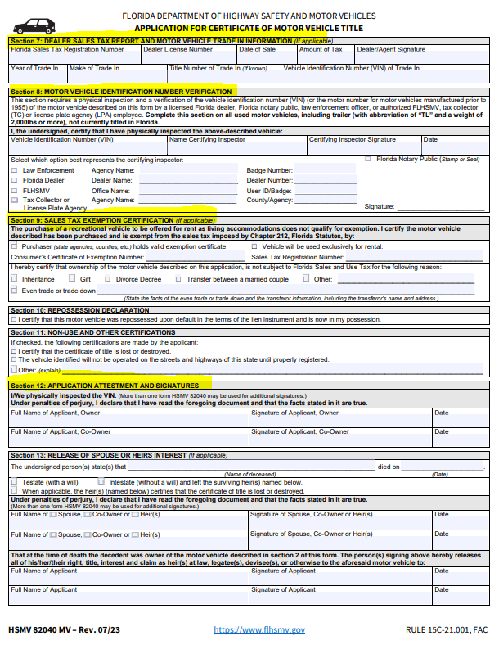
HSMV 82040 MV (Motor Vehicle)
Section 1
If the box is not checked for the title to be printed, it will remain electronic
Section 2
If you do not fill in a license plate number, we will issue a new plate. If this is a truck weighing over 5,000 you must fill in the GVW the customer is declaring
Section 4
If there is a lienholder, this section should be complete
Section 7
Complete this section with dealer and trade-in information
Section 8
This section should be complete and signed if the title being transferred is not a Florida title
Section 9
If there is an even trade or a trade down this section should be completed (the trade must also be listed in section 8)
Section 12
We need original signatures from all applicants , or by POA if applicable

Slide 12
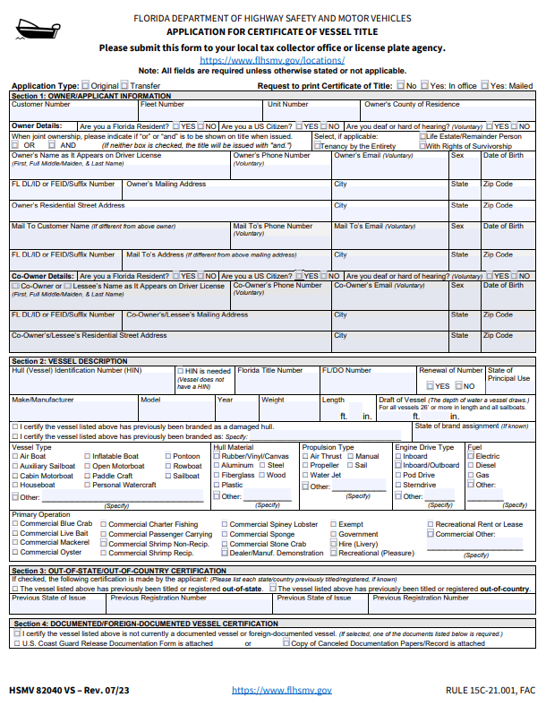
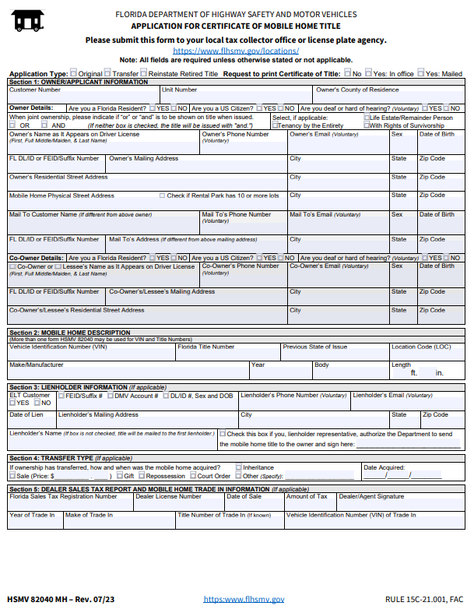
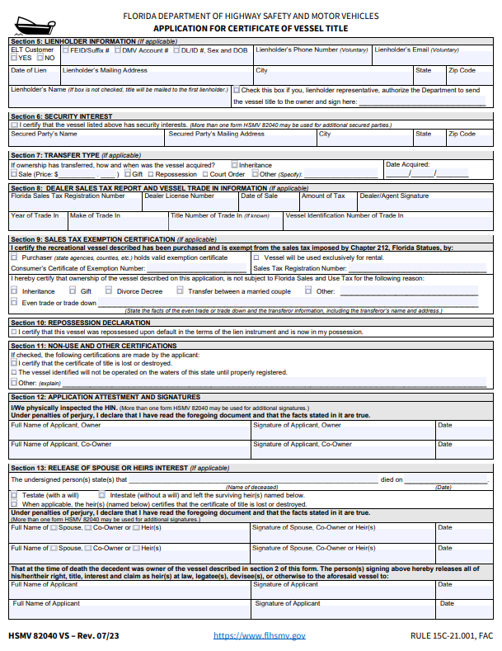
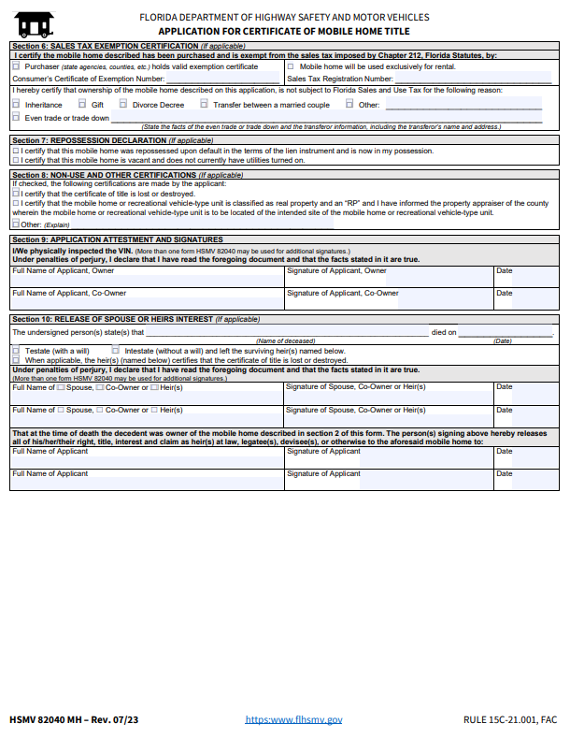
HSMV 82040 VS HSMV 82040 MH

Slide 13
Identification and Signature Requirements
All applicants must sign the HSMV 82040. If the applicant’s proof of identification is something other than a Florida driver license or ID card, the dealer must submit a copy of this proof with the application. Acceptable forms of identification are:
A valid out of state driver license or ID card
A valid passport
A valid Canadian driver license, ID card, or passport
A valid driver license or ID from any US Territory
If the applicant is a business, you must provide documentation to prove the validity of the business and that the person signing the application is authorized to do so. A few examples are:
A printout from Sunbiz.org showing the business is active
Fictitious Name Documents
Incorporation papers
County or City Business License

Slide 14
Electronic Signatures
Effective March 2020, the department began accepting electronically signed versions of HSMV 82040, 82993, 82994, and 82995 used to make odometer disclosure submitted by dealers and manufacturers.
Dealers must use an electronic signature solutions that allows the odometer disclosure forms to be signed via a signing device, such as a signature pad, or signed through a compliant process using email.
The electronic signature process must use an identity proofing/authentication protocol or methodology to determine the identity of the signer which meets the National Institute of Standards and Technology assurance level 2.
Dealers must submit an electronic signature certification page (audit trail), attestation statement on letterhead, and all other documents related to the transaction.
Dealers must maintain records related to the signature authentication.
Information Notice INFO20-010 created by FLHSMV provides detailed instructions for use of electronic signatures.

Slide 15
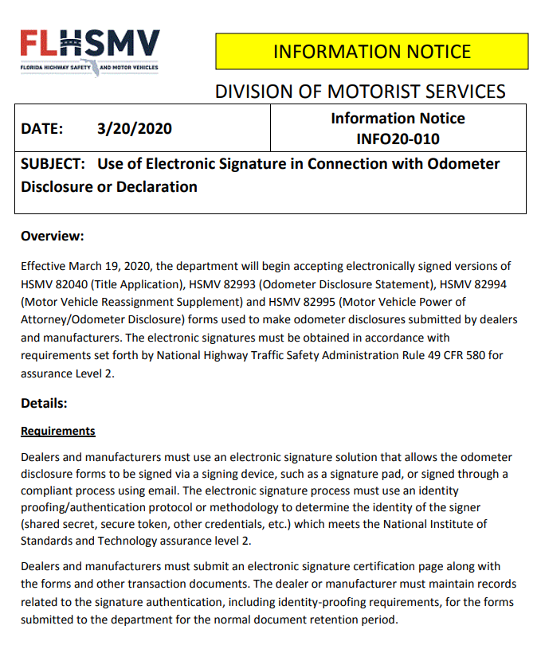
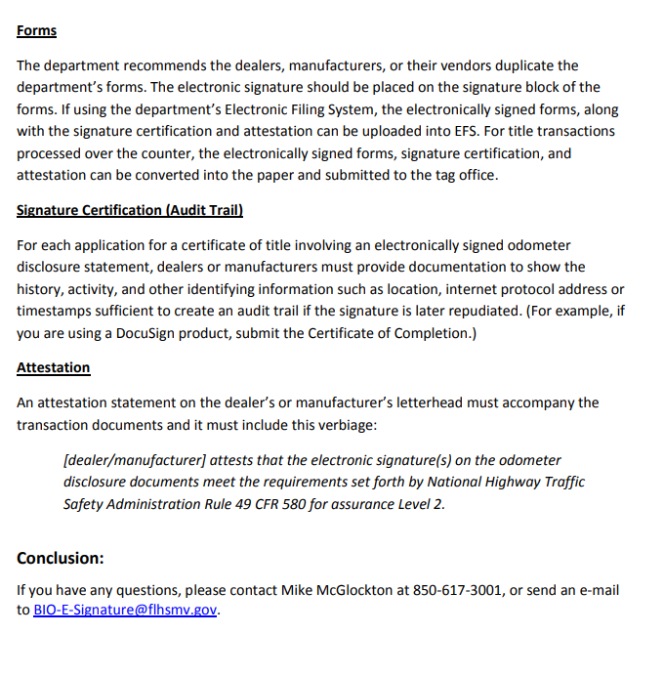
Electronic Signatures

Slide 16
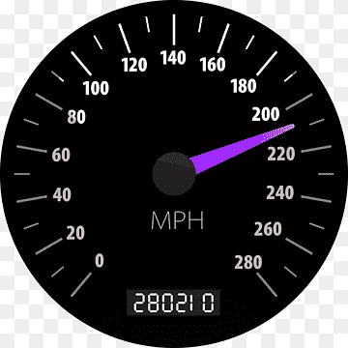
Odometer
Common Odometer Errors
Omission – Any part of the odometer disclosure that is incomplete
Alteration – A strike over, erasure, ink over, white out, or any other method of change to an odometer disclosure
Discrepancy – An odometer reading or date appearing on any documented submitted that is lower or precedes a previously recorded amount or date
Transactions that require Odometer Disclosures
New Car – original
Used Car – original
Transfer
Vehicles that may be EXEMPT from Odometer Disclosures
Heavy Trucks declaring Gross Vehicle weight of 16,000lbs or more
New motor vehicles, covered by an MCO, transferred between dealers
Note: when the vehicle is transferred to an individual, an odometer disclosure will be required

Slide 17
UPDATE EFFECTIVE JANUARY 2021
The National Highway Traffic Safety Administration (NHTSA) changed the odometer disclosure exemption requirements for motor vehicles. The new 20-year odometer capture exemption requirements apply only to vehicles that are 2011 model year or newer. Vehicles manufactured with a 2010 model year or older remain exempt under the 10-year exemption. With this final rule, beginning on January 1, 2021, model year 2011 vehicles will not become exempt from the requirements until January 1, 2031. States are required to capture the odometer reading for model year 2011 until 2031. Therefore, any title transfer that occurs on or after January 1, 2021 on a model year 2011 or newer vehicle, requires an odometer disclosure to be completed.

Slide 18
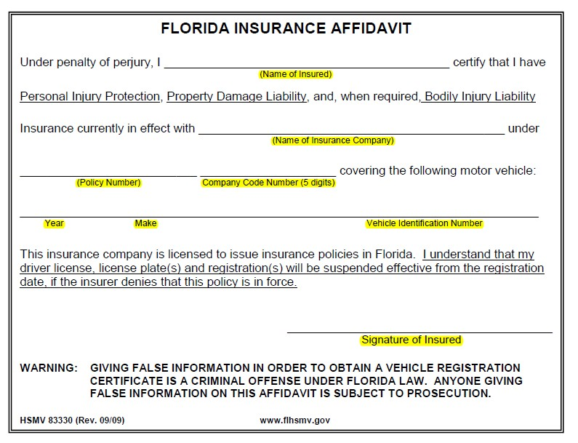
Insurance
All forms of acceptable insurance must include the Florida 5-digit company code or the NAIC code.
Acceptable Proof of Insurance
Florida Automobile Insurance Identification
Card
Florida Insurance Policy or Certificate
Insurance Binder
HSMV 83330 (Florida Insurance Affidavit)
Note: Trucks declaring a GVW (gross vehicle weight) over 26,001lbs must submit a certificate of liability as proof of insurance.

Slide 19
Send Backs
Unfortunately, there are times when we will need to send out your work. We will always provide a checklist of what is needed to correct the errors. This sheet must be returned when re- submitting the work to be processed.
Most Common Errors | Correction
Missing odometer reading or date read | HSMV 82993/HSMV 82994
Odometer reading discrepancy or mark over | HSMV 82993/HSMV 82994 and original letterhead affidavit
Incorrect name or any other information not related to odometer | Original Affidavit
Incorrect License Plate Number | Original Affidavit

Slide 20
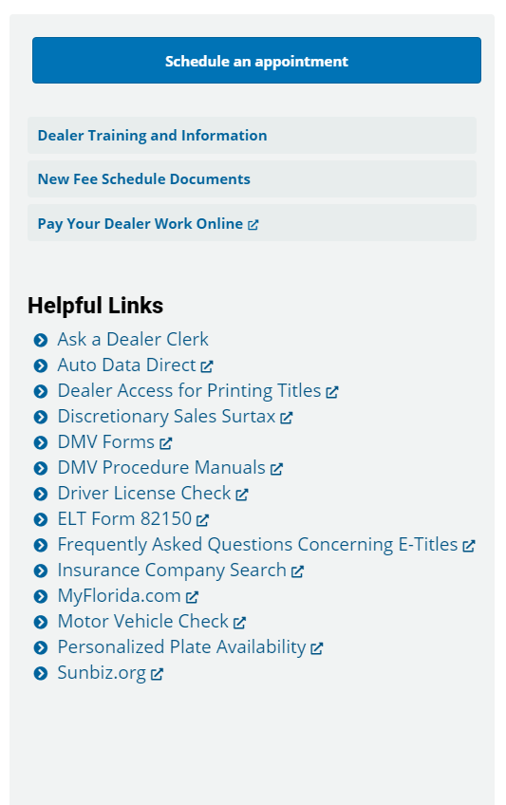
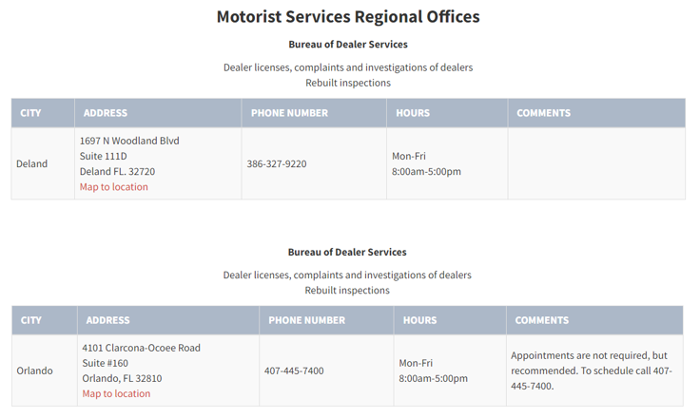
www.flhsmv.gov
www.seminolecounty.tax

Slide 21
